Slide 1
Animal Count
Even or Odd

Slide 2
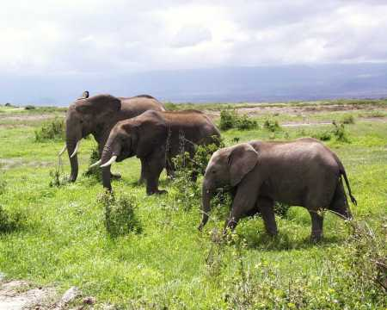
Three elephants in a row.
Is the number 3 odd or even?

Slide 3
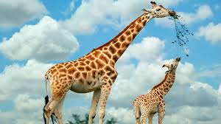
Two giraffes standing straight and tall.
Is the number 2 odd or even?

Slide 4

Eight Hippos bathing in the sun.
Is the number 8 odd or even?

Slide 5
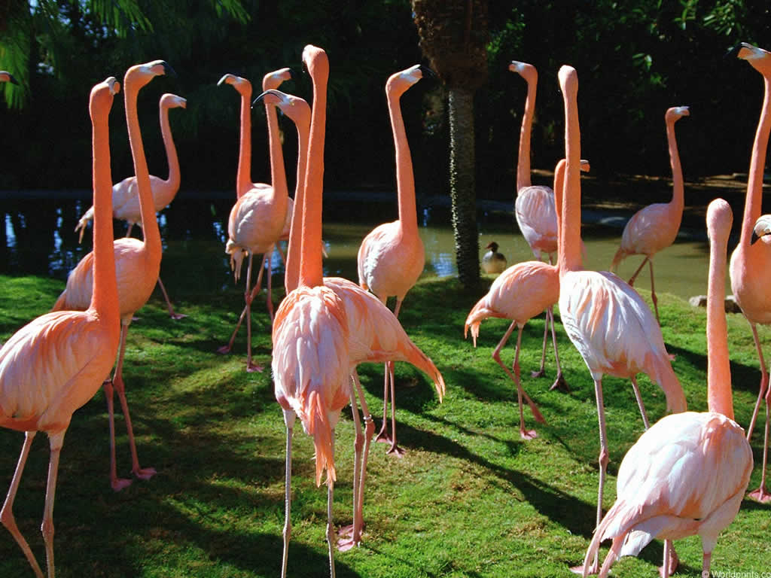
Fourteen flamingos strutting on the lawn. Is 14 odd or even?

Slide 6
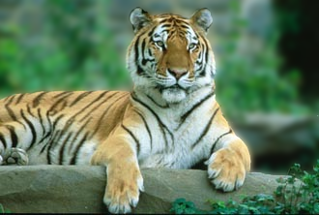
One tiger resting on a log. Is the number 1 even or odd?

Slide 7
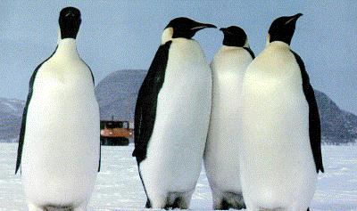
Four penguins walking side by side. Is the number 4 odd or even?

Slide 8




All of these animals living in a zoo. They know if they are odd or even, do you?
Three elephants –3 is an odd number
Two giraffes – 2 is an even number
Eight hippos – 8 is an even number
Fourteen flamingos- 14 is an even number
One tiger – 1 is an odd number
Four penguins – 4 is an even number

